Slide 1




Growing Category
Positioned for Growth: Alvarinho is up +5.0% in value to $23M and +3.0% in volume to 107K 9L cs*
Optimally Priced: Vinho Verde $10-15.99 are up +29.4% in value to $4M and +24.5% in volume to 32K 9L cs*
From Quinta de Azevedo – A Historic Winery
First bestowed “Honra de Azevedo” in the 12th century, the estate was recognized for its close ties to the royal court
Located in the Barcelo’s commune, a top-quality area for Vinho Verde production
Home of the native yeast QA23, used globally in the production of premium white wines
*52W Nielsen w.e. 01.24.26
Imported by Evaton | www.evaton.com | @evatonsogrape

Slide 2
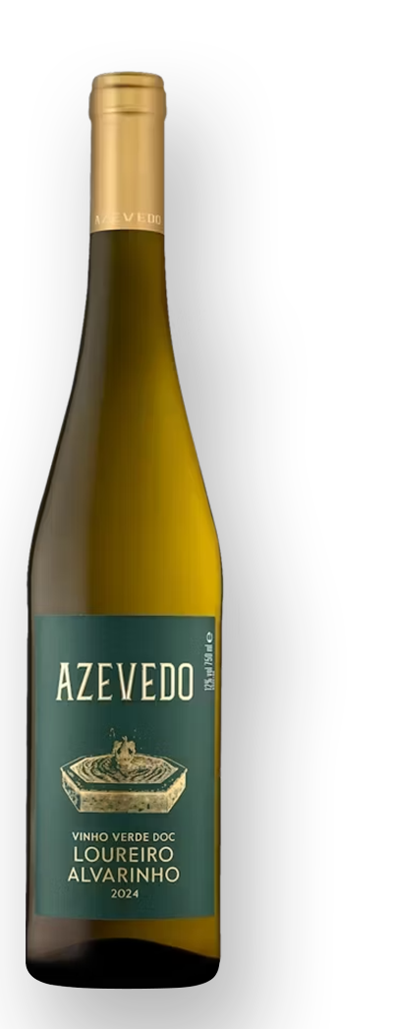

Loureiro Alvarinho
Vinho Verde DOC
2024
Overview: Fresh and elegant white wine, offering a premium alternative to Sauvignon Blanc and Pinot Grigios at great value
Varieties: 70% Louriero, 30% Alvarinho
Winemaking: Grapes are destemmed and cooled for gentle pressing at low temperatures.
The must is sent to stainless steel vats for decanting and alcoholic fermentation at a temperature of 14-15ºC. Before pressing, part of the batch undergoes pre-fermentation maceration for up to 2 days at low temperatures.
Aging: Ageing on lees in stainless steel vats with batonnage for 3 months
Tasting Notes: Exuberant aroma with notes of tropical fruit, white flowers and stone fruit. Very crisp and vibrant in the mouth, with well-integrated volume and firmness. Salivating, lingering aftertaste.
Enjoy: Fish dishes, sushi, fresh salads, seafood and pasta dishes
ABV: 12% TA: 6.0g/L RS: 2.0g/L pH: 3.1
SRP: $12.99 (12 x 750mL)
Imported by Evaton | www.evaton.com | @evatonsogrape

Slide 3


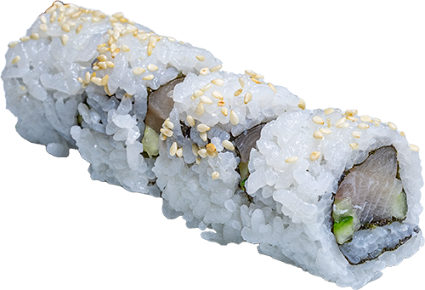
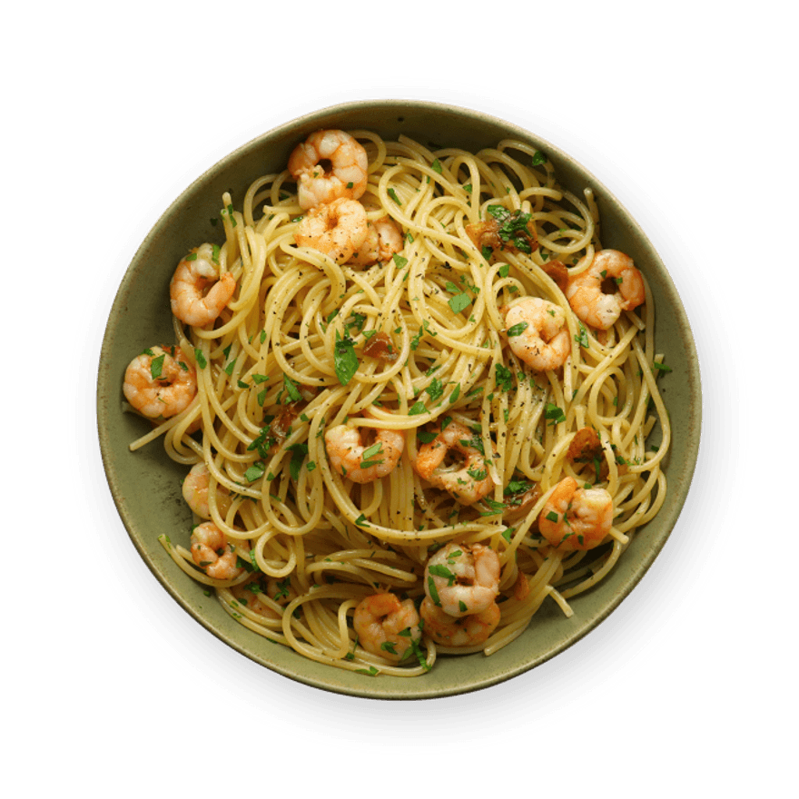
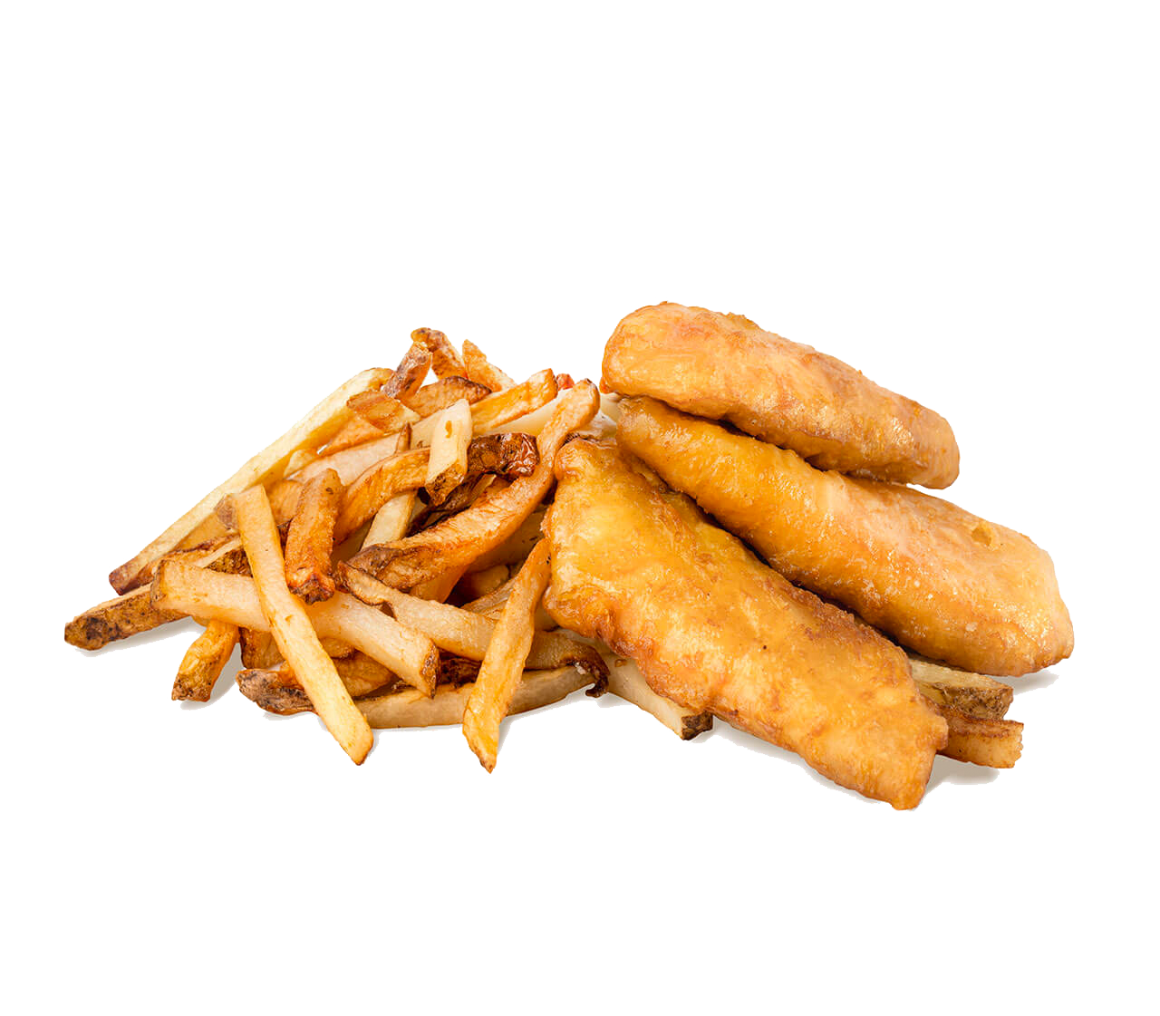
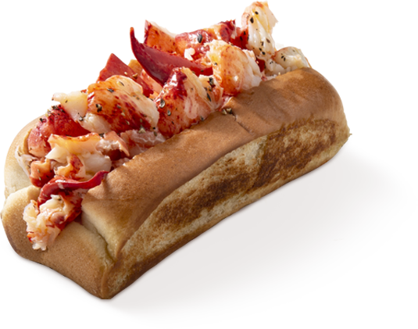

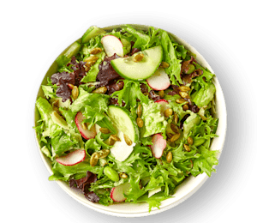

PAIRING GUIDE
Asian Cuisine: Banh Mi Sandwich • Tonkotsu Ramen • Spicy Sushi Roll
Quintessential American Seafood: Lobster Roll • Shrimp Scampi • Fish & Chips
Neighborhood Bar Favorites: Deep Dish Pizza • Spring Salad • Jalapeño Poppers
The herbal and fruit-forward notes in the wine will match greens in salads and fermented vegetables
  This will also benefit spicy dishes because it’ll bring the heat down
The acid in the wine will help clean the palate, bring freshness, and create a sensation of lightness, which will cut through the heaviness of cream and oil-heavy dishes
Imported by Evaton | www.evaton.com | @evatonsogrape

