Slide 1
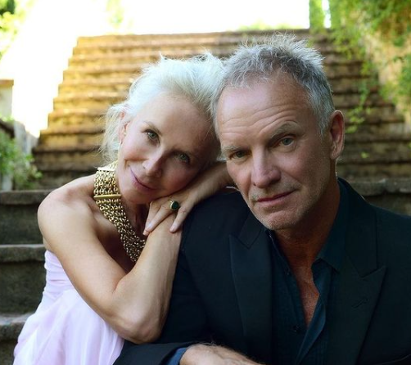
WHEN WE DANCE 2019
CHIANTI D.O.C.G.
“A wine is like a song; it has to tell a story.”
– Sting
VARIETIES: 95% Sangiovese & 5% Canaiolo & Colorino
THE ESTATE: From the Figline Valdarno ( Firenze ) district
grown 1,082 feet above sea level in soil composed of sand and clay rich in magnesium and calcium
WINEMAKING: Hand-harvested the middle of September; Fermented- in stainless steel tanks; Maceration - 2 days at 10°C - 5 days at 28°C/30°C; Aged in stainless steel for about 6 months
TASTING NOTES: Aromas of ripe black cherries, sandalwood, cedar and strawberry compote. Texturally even and balanced bright acidity, juicy fruits and a joyful, lingering sense of the vineyards at Il Palagio
PAIRINGS: Perfect for combining with traditional Tuscan recipes.
ABV: 13%
SRP: $19.99
BEYOND
MUSIC
the
Released in 1994, the song “When We Dance” is about holding on to the perfect ideal of forbidden romantic love.

