Slide 1
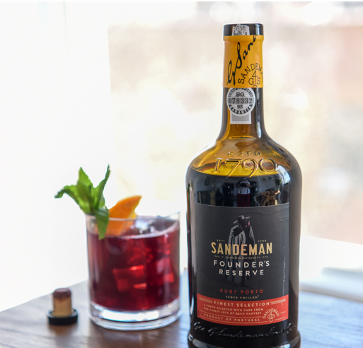
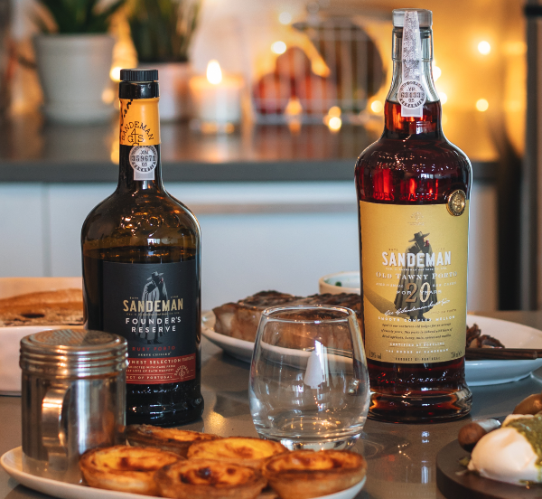

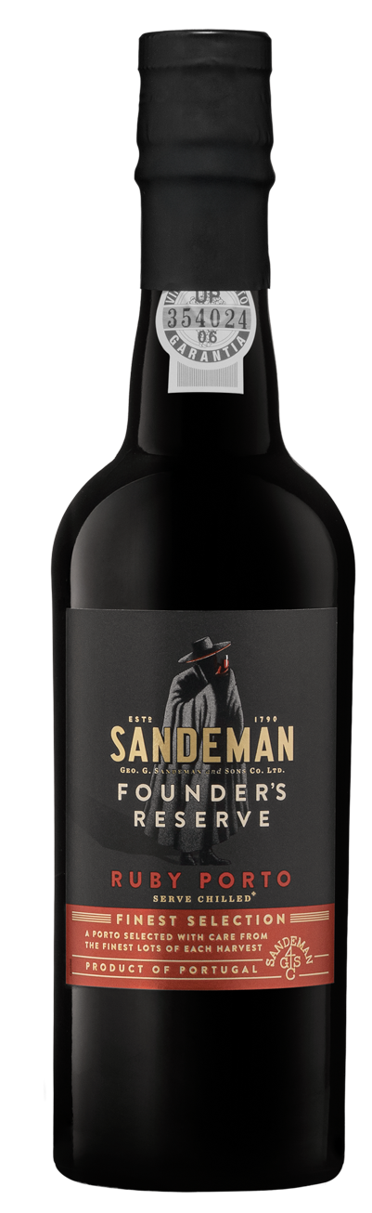




THE WORLD’S
MOST AWARDED
PORT WINE
NEW: FOUNDER’S RESERVE 375ML COMING SOON
*
THE HOUSE OF SANDEMAN
Founded in 1790 with over 230 years of quality and innovation
Sandeman is the #1 Imported Port in the US by volume*
Sandeman is known for its elegant and vibrant house style
FOUNDER’S RESERVE RUBY PORT
Named in honor of the Founder, George Sandeman, this reserve is one of Sandeman’s greatest Ports
Selected from the finest lots of each vintage and aged for 5 years
Full of the power, fruit, and fire that distinguishes Ruby Port
Serve chilled, on the rocks or in your favorite cocktail
NEW 375ML Format
Convenient format perfect for by the glass & hotel mini bar programs
Retail flexibility and driving trial & impulse purchase
SPECS
SRP: $15.99
375ml / 12pk
Available to ship September 1, 2025
CASE |  |  |  | BOTTLES |  |  |  | PALLET
Case Weight Pounds | Case Length Inches | Case Width inches | Case Height inches | Bottle Weight Pounds | Bottle Length Inches | Bottle Width inches | Bottle Height inches | Case Per Layer | Layers Per Pallet | Cases Per Pallet
18.96 | 10.83 | 8.15 | 10 | 1.58 | 2.54 | 2.54 | 9.28 | 19 | 6 | 114
Sources: Nielsen L52W w.e. 06.14.25, Decanter World Wine Awards, International Wine Challenge, and International Wine and Spirits Awards
SANDEMAN.COM
/TheSandemanDon
@SandemanPorto

